Slide 1

Sandwich Maker | Group 3| Kevin, Gio, Jonathan, & Philip

Slide 2
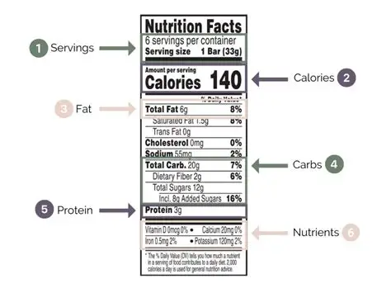
Project Goals
The goal of this project was to make nutritional awareness easy and accessible for everyday use
Instead of manually looking up the calories and macros for every meal, our program automates it by allowing the user build their sandwich and instantly see a complete nutritional breakdown
This helps people who are tracking their consumption, health, or those who are curious about making informed food choices without extra effort

Slide 3
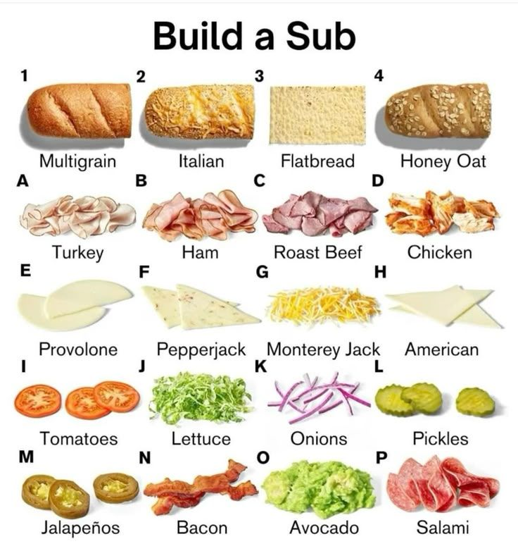
Description
Our tool is a sandwich builder with a built in nutritionist
You pick your bread, protein, cheese, vegetables, and condiments from a menu while the program does all the work behind the scenes
Once your sandwich is built, it adds all selected options and gives a full breakdown of the calories, protein, carbs, and fats
It also provides you with a visual chart
Think of it like a nutrition calculator, but for a sandwich you build yourself.

Slide 4


Use Cases
Fitness and Diet Tracking:
Someone who is actively tracking macros for a fitness goal, to build muscle or lose weight can use this to make sure their meal fits their nutritional targets. While having some of the extra payload taken of their shoulders
Health Conscious Eating:
This can be for someone told by a doctor to monitor their fat, carb, or overall intake to make smarter ingredient choices. For example, a person managing their cholesterol level can compare different proteins or cheeses to see how swapping one ingredient for another changes their macros.

Slide 5

Technology
Technology Used: Our project uses the FatSecret API, which requires authentication and is used to look up the nutritional information for each sandwich ingredient. We also used QuickChart, which is a simple URL-based service that takes our final macro totals and generates a visual bar chart that opens directly in the browser.
Python Modules Used: Our program relies on four built-in Python modules to function. The requests module allows our program to send calls to external APIs and receive data back. The json module is used to format and read the data being exchanged between our program and the APIs. The urllib.parse module encodes our chart data into a URL format that QuickChart can understand. Finally, the webbrowser module automatically opens the generated QuickChart link in the user's default browser.

Slide 6

Program Flow
The program walks the user through each ingredient categories where they select their ingredients by entering numbers which stand for each ingredient.
Once the sandwich is built, the program connects to FatSecrets database to search for every selected ingredient and pull its macronutrient data. The program then adds up the Calories, Protein, Carbs, and Fat across all ingredients to produce a total macro breakdown. Finally, a detailed summary is printed to the console and a bar chart automatically opens in the browser using QuickChart to visually display the results.

Slide 7

Document One Error Encountered
The Issue: When combining all of our code into one file, running the program produced no output would appear after the user inputs all their ingredients leaving us with a NameError. Not allowing us to see the information our API has gathered for us.
The Cause: When merging the code, our if __name__ == "__main__": block ended up near the top of the file, above all of our function definitions. It tried to call get_token(), calculate_total_macros(), and print_final_summary() before those functions had been defined.
The Fix: We moved the if __name__ == "__main__": block to the very bottom of the file, after all function definitionsto make sure python had already read and stored every function in memory before attempting to call them.

Slide 8
Team Members
Kevin (Input System) - Built the ingredient selection system, creating a dictionary of preset options across five categories and walking the user through picking their sandwich ingredients by number.
Jonathan (API Implementation) - Connected the program to the FatSecret nutrition database, handling authentication and retrieving the Calories, Protein, Fat, and Carbs for each selected ingredient.
Phillip (Calculations) - Took all of the individual ingredient macros returned by the API and added them together to produce a complete nutritional breakdown for the entire sandwich.
Gio (Output/Error Handling) - Designed the final sandwich summary display, handled errors such as bad input and API failures, and integrated QuickChart to automatically open a visual bar chart of the total macros in the browser.

Slide 9
Related Documents
FatSecret Platform API - https://platform.fatsecret.com/
FatSecret List of Foods - https://foods.fatsecret.com/calories-nutrition/
QuickChart - https://quickchart.io/
W3Schools - https://www.w3schools.com/python/default.asp

Slide 10

Any Questions ?

